Slide 1
Rotary Kiln Data Acquisition and Controls Upgrade
Capital Project Proposal Presentation

Slide 2
Project Goals
Primary Goal (Core Project Driver):
Improve operational consistency of the rotary kiln.
Secondary Goals (Critical Project Elements):
Increase internal knowledge of rotary kiln controls, and control systems in general.
Thoroughly understand & document process.
Build a robust knowledge base (prevent point-person dependence).
Exploratory Goals (Potential Gains/Improvements Uncovered During Project):
Increase operational flow rate.
Increase process reaction yield.
Reduce/eliminate clinker rings in the kiln.
Reduce kiln brick degradation.

Slide 3
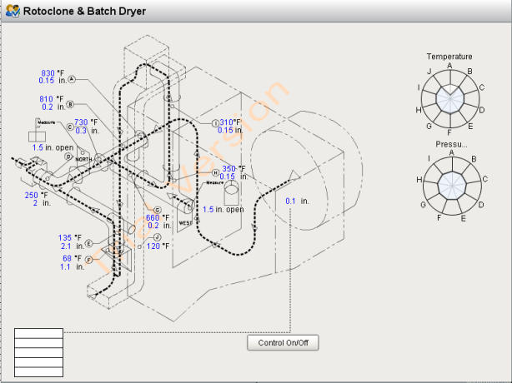
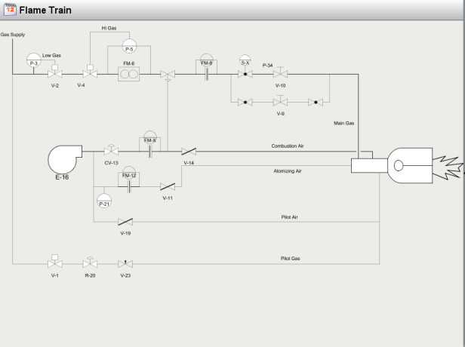
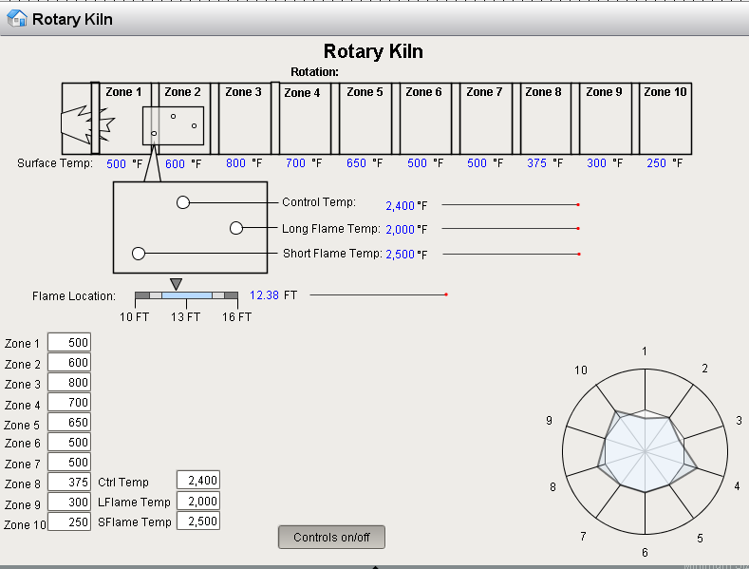
Full Project Scope
Three Phase Project:
Phase One: Dusthouse/Dryer/Rotoclone
Build Pressure & Heat Controls
The Focus of this Meeting
Phase Two: Flame Train System Upgrade
Highlight alarms in process & flow meters for fuel optimization.
Phase Three: Kiln Temperature Profiling
Monitor short/long flame & steady state kiln temp profile

Slide 4
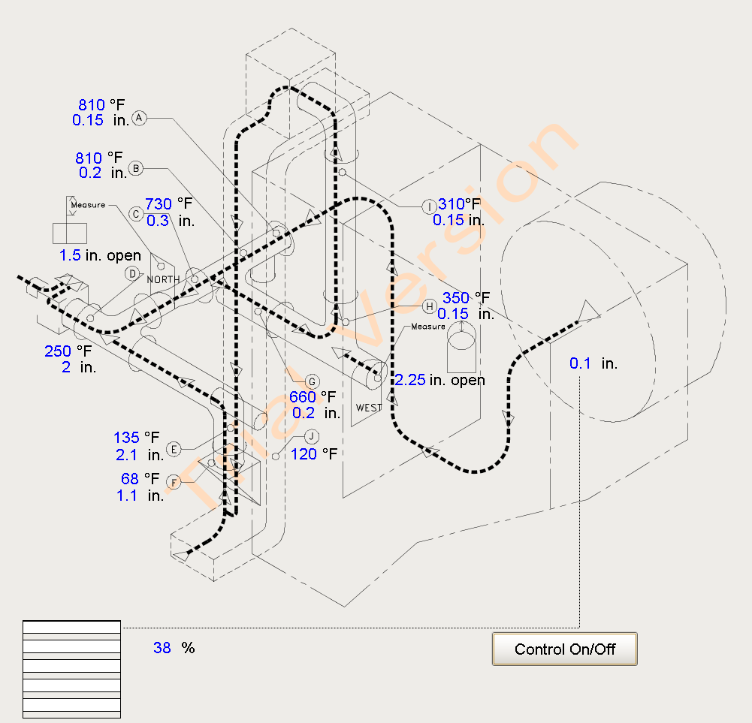
First Phase Expanded Scope
Implement new control system to replace old, non-functioning pneumatic controller.
Replace broken manual temperature and pressure gauges with digital indicators.
Experiment with effects of process changes utilizing new indicators.
Build controls for dryer system based on experimentation.

Slide 5
Project Timeline
Project Submission/Approval: 1 week
Capital Lead Time and Dusthouse Install: 9.5 weeks ( 5 week lead time on controller)
Dust House Pressure Control Testing: 5.5 weeks
Complete Installation (Dryer system): 1.5 weeks
Dryer System Control Testing: 6 weeks
Total: 23.5 weeks
See layout: https://app.smartsheet.com/b/home?lx=N4OUXAf6B3I8L6I0yzplWg

Slide 6
Project Costs
HC 900 controller | $7,175
Control Station & Software | $3,505
Thermocouples | $500
Pressure transducers | $1,500
Temperature display | $3,300
West & North gate actuators | $300
copper tubing - pressure sensors | $360
Electrical Cabinet | $2,200
Wiring | $215
Conduit | $50
Ceramic tube insert | $100
Replacement damper & actuator | $400
John Clause Labor | $4,000
Total | $23,605

Slide 7
Project Payback

Slide 8
Project Risks
Project Risks | Response
Controller Setup Improperly | Work closely with John Clause to ensure proper implementation. Confer with Tim Hastings as back-up check.
Negative Impact on Production | Almost impossible, as we are manually managing process control now (poorly.) Worst case is controller failure after comissioning. In this worst case, we can always go back to manual control.
Delay of Project Implementation due to maintenance unavailability | Option to outsource electrical work. Will add cost to the project. Alternatively, accept delays
Delay of Project due to production not running | This is a reality we must accept. Will work with Chandra to give input on best times to run for project, but ultimately production comes first.

